Slide 1




BANK MANAGEMENT SYSTEM
By Team
Ajit Gupta
Vikash Mehta
Nitish Kumar

Slide 2
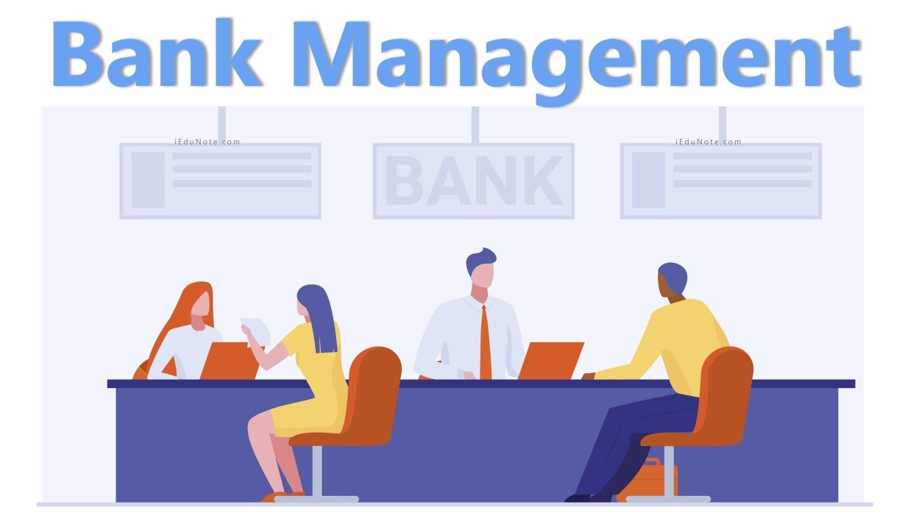
Introduction
The Bank Management System automates
banking tasks, ensuring efficiency and security.
Purpose and importance
To handle all banking operations like:-
Opening
New account
Cash withdrawal
Cash deposits and other things .

Slide 3

Tools and Technologies
Programing Language :- C
Platform :- Dev C++
Version :- 5.11.0

Slide 4
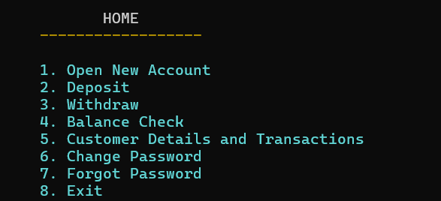
System Features
Open Your Account
Deposit
Withdraw
Balance Check
Customer Details and Transactions
Change Password
Forgot Password

Slide 5

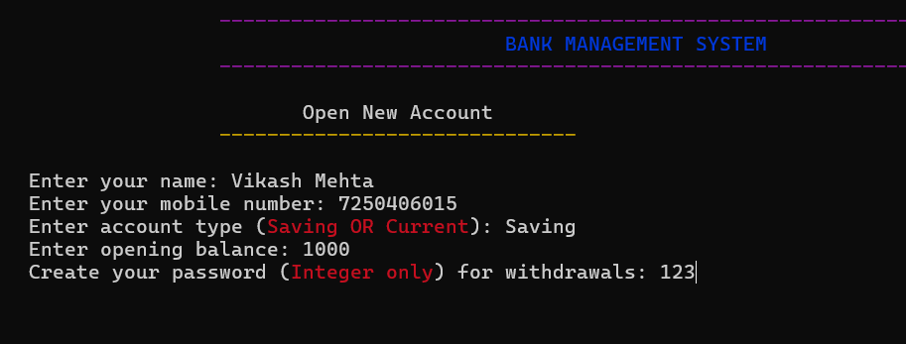
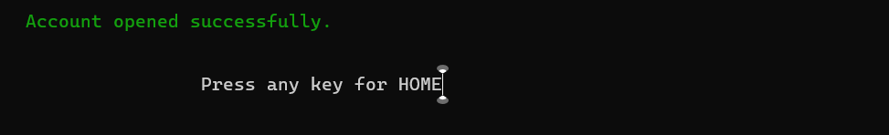
Open New Account
The "Open New Bank Account" feature allows users to create a new account by providing essential details like :-
Name
Mobile Number
Account type
Opening Balance
Password
This process ensures accurate record-keeping and facilitates smooth banking operations.

Slide 6
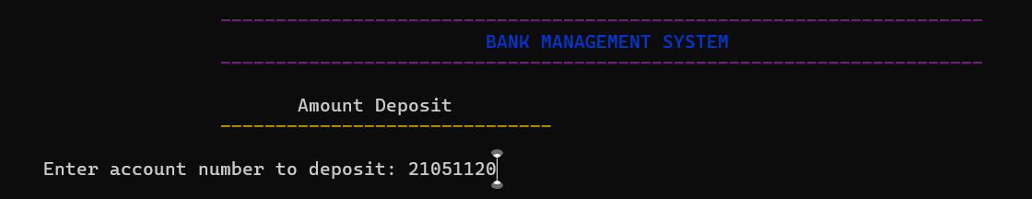
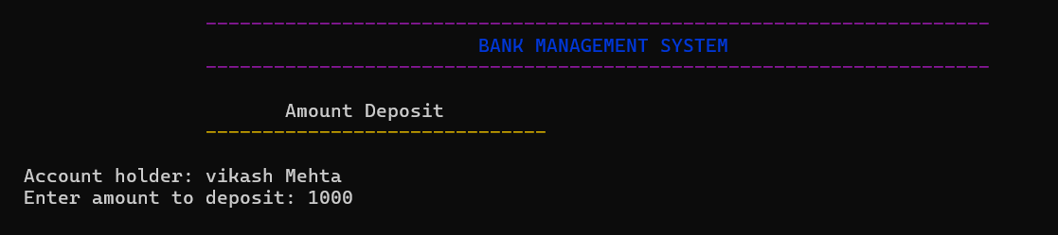
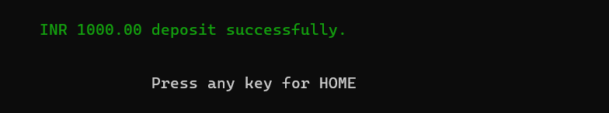
Deposits
Deposit funds into an account and update the balance
Adds money to an account and records the transaction.

Slide 7
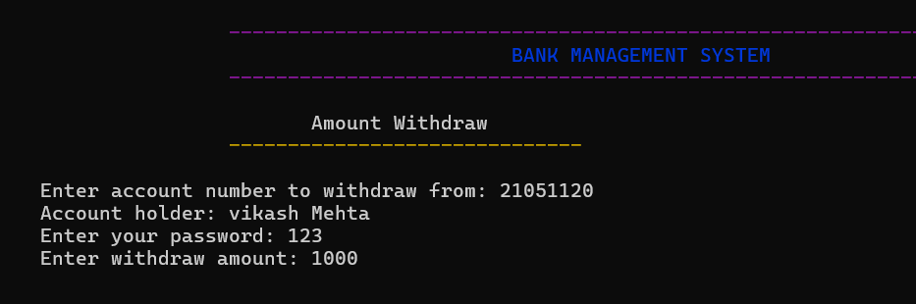

Withdrawal
Withdraw funds securely, requiring the user to enter the correct password and ensuring sufficient balance.
Allows withdrawal from an account after password verification.

Slide 8
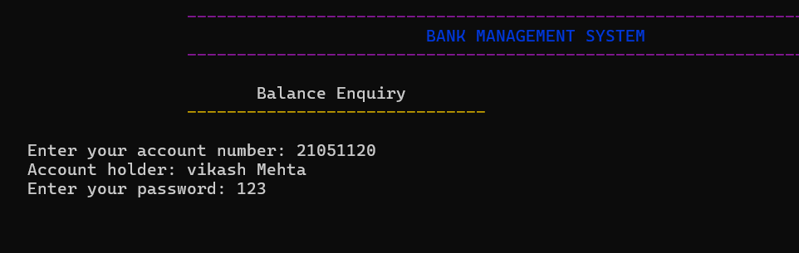

Balance Check
Using balance check option customer can check their
account balance with password authentication

Slide 9
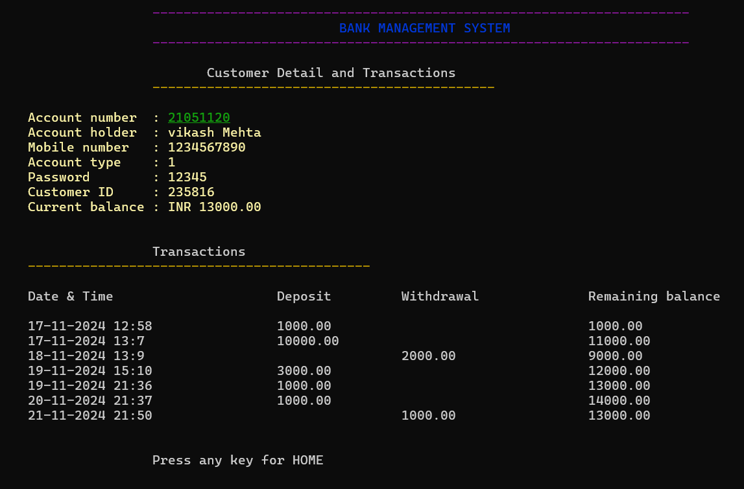
Customer Details and Transactions
Customer can see their account details.
After password verification.
All previous transactions
like withdrawal and deposits history.

Slide 10
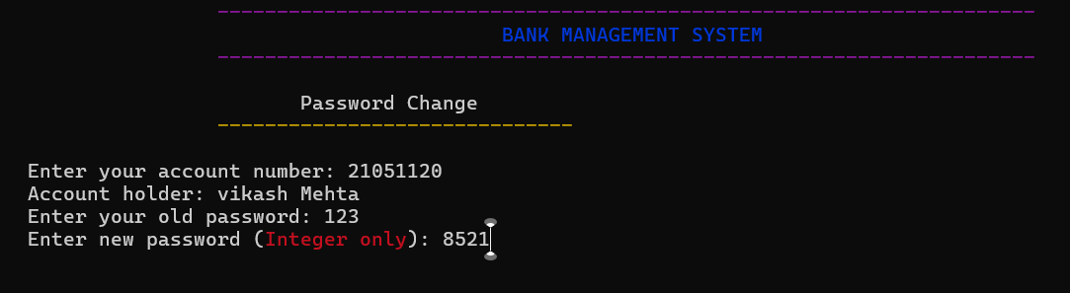
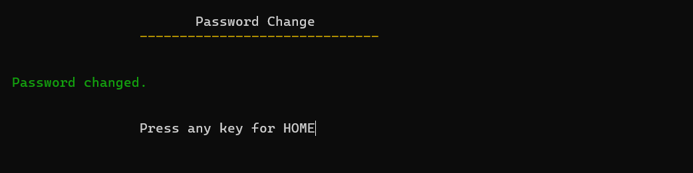
Change password
Customer can change their password
with the help of previous password.

Slide 11
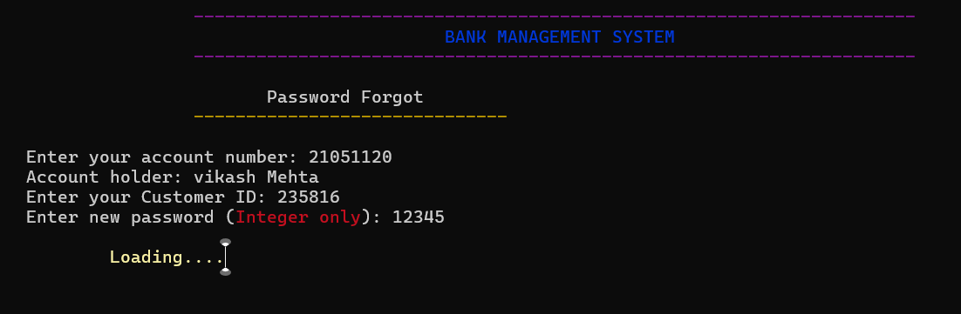
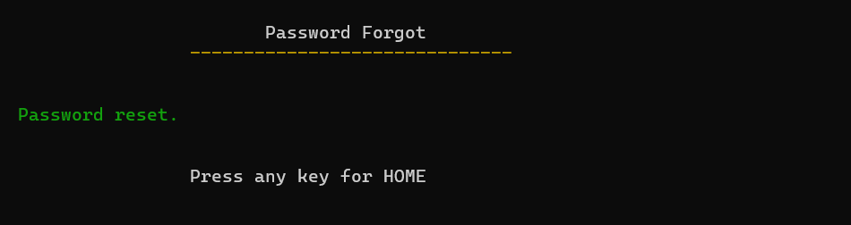
Reset password
Customer can reset their password
with the help of customer ID.

Slide 12
Summary
Open new Account: Registers a new account and saves the details.
Deposit Money: Adds money to an account and records the transaction.
Withdraw Money: Allows withdrawal from an account after password verification.
Check Balance: Displays the current balance for an account.
Account Details with Transactions: Shows account details and transaction history.
Change or Reset Password: Allows users to change their account password.
Note:- Each of these functionalities is protected by security checks, including password validation for transactions.

Slide 13

THANK YOU…
By Team
Ajit Gupta
Vikash Mehta
Nitish Kumar

